Slide 1
Software Testing
Version Control Systems

Slide 2
Version Control
Version control systems are
repositories for software that are able to maintain multiple versions of the software.
This means it is able to save the previous version as well as the new version.
The advantage of this is that if you make a mistake and you need to revert to a previous version, this can easily be done.
Version control can be run
Locally on your computer
Remotely on a network server
Git is one of the most popular version control systems today.
Seneca runs its own server at:
https://github.senecacollege.ca
You must use the VPN to access this

Slide 3
Git Clients
A Git client is a program which communicates with either a local or remote Git repository.
The Git client is able to
creating a clone of the repository,
add new files to the repository, and
retrieve information about the repository.
There are many different get clients available.
TortoiseGit is integrated into the Windows file browser

Slide 4
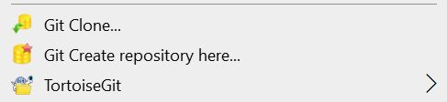
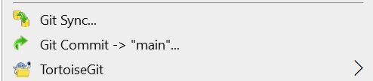
TortoiseGit Menus
Non-repository
Repository

Slide 5
Working Copies
You clone the remote repository to your computer
This creates a local copy of the repository
You make changes to the local repository
You commit the changes to the local repository
Stage the files you want to be in the next push
You push the committed changes to the remote repository so others can share your work

Slide 6
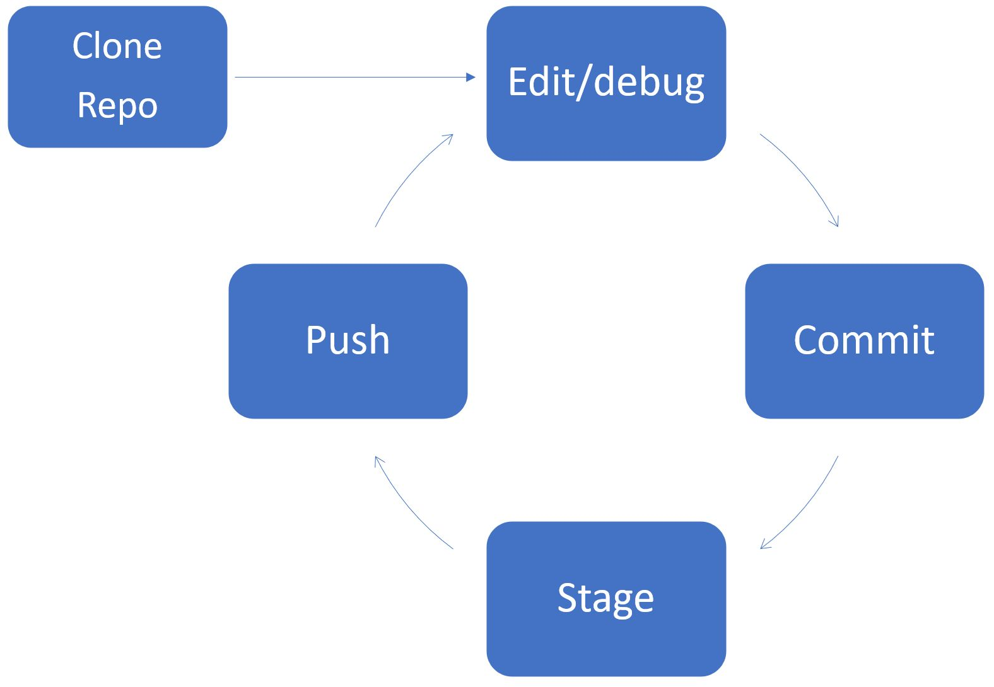
Working Copies

Slide 7
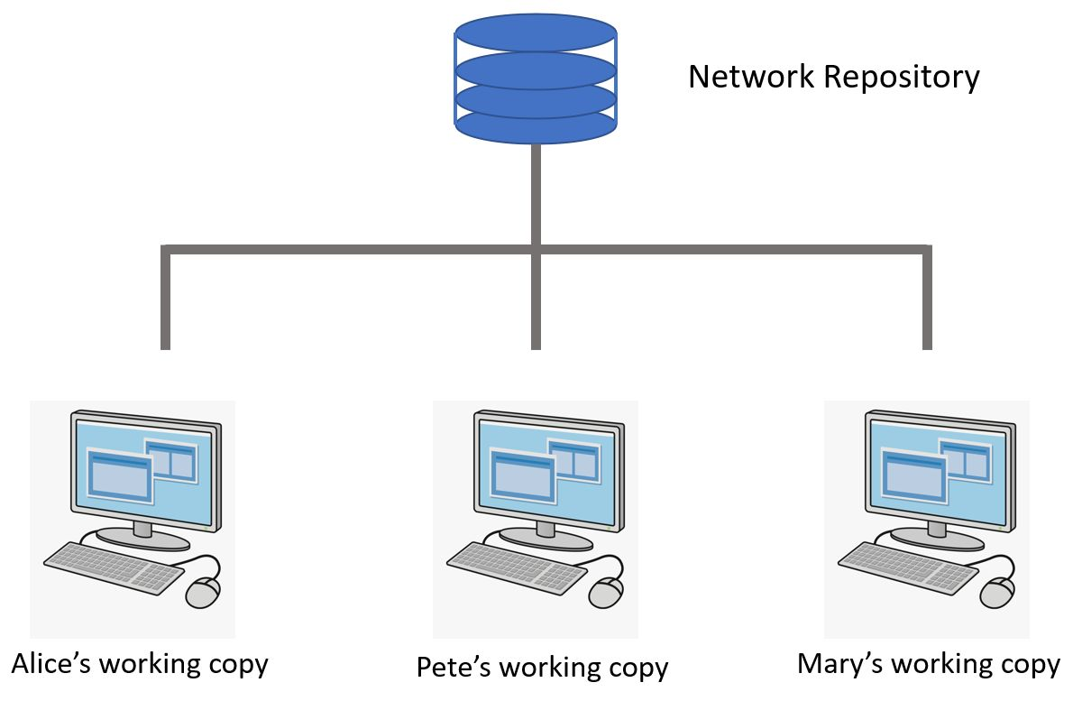
Working Copies

Slide 8
File Status
Git only versions the files you ask it to
Projects have many intermediate file like object and executable files which can be rebuilt
You must add a file to Git to have it tracked or versioned
Once tracked, it tells you if the file has been modified
You can then stage the file and commit it

Slide 9
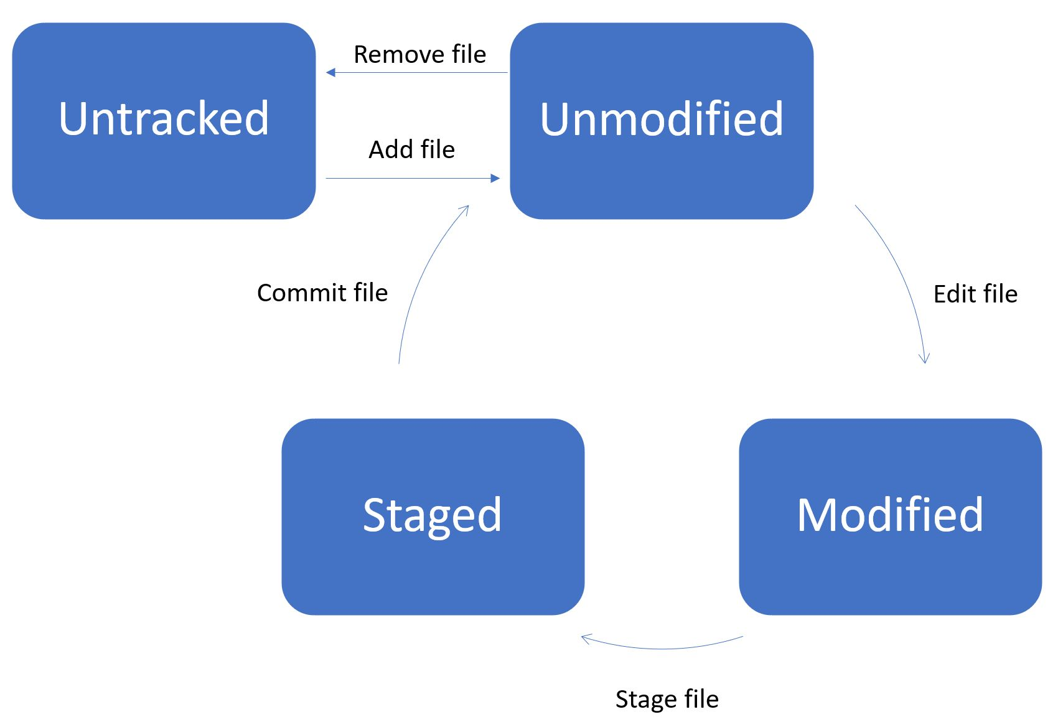
File Status

Slide 10
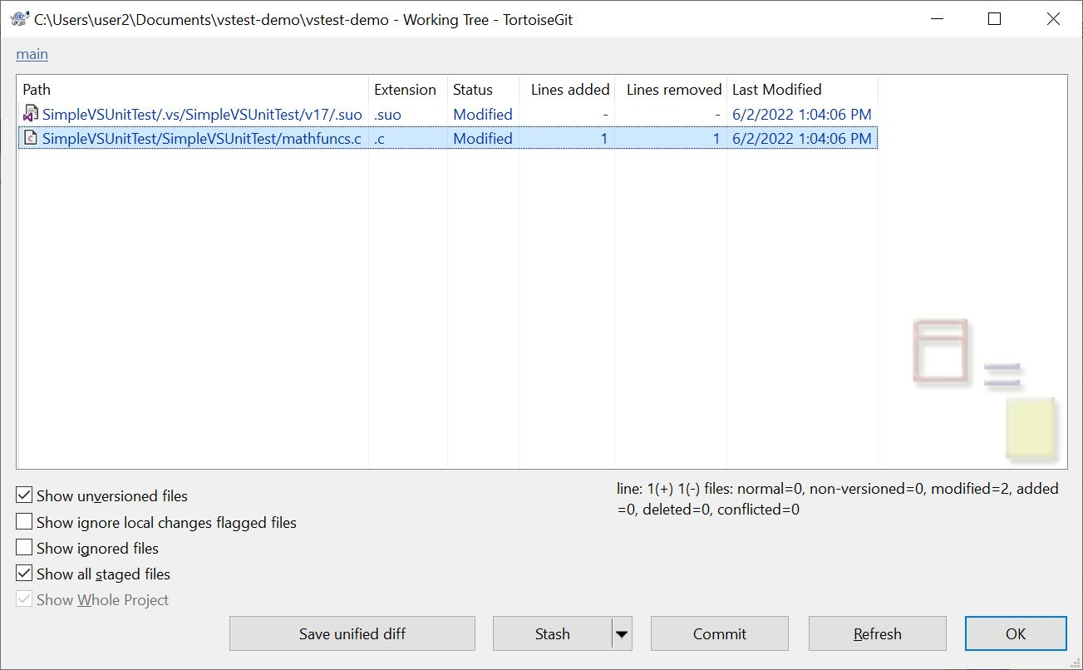
Tortoise: Check for Modifications

Slide 11
Ignoring Files
You want Git to ignore temporary files
List patterns for them in a .gitignore file
*.vsidx *.lock *.ipch *.testlog *.tlog *.log *.VC.db *.manifest *.VC.db-shm *.VC.db-wal *.VC.db-opendb

Slide 12
Communicating with the Remote Repository
Clone – creates a local copy of the repository
Pull – updates your local copy with changes from the remote
Push – pushes your local changes to the remote

Slide 13
Other Actions
Rename – change the name of a file tracked by Git
Delete – stop a file from being tracked by Git

Slide 14
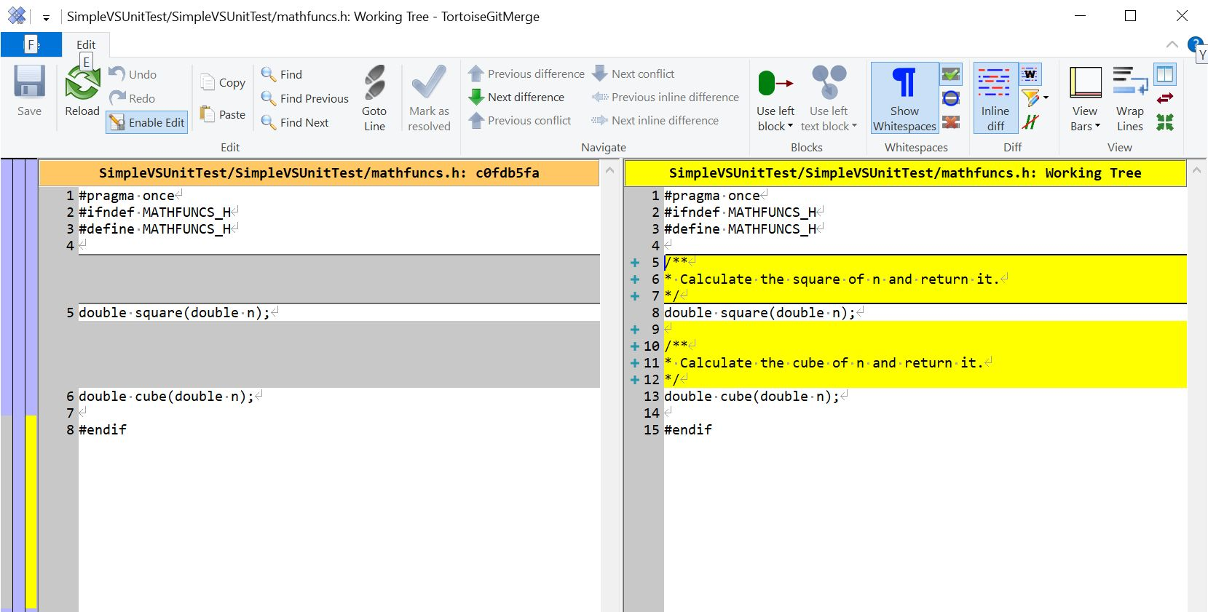
Viewing Changes
Check for Modifications | Compare with Base

Slide 15
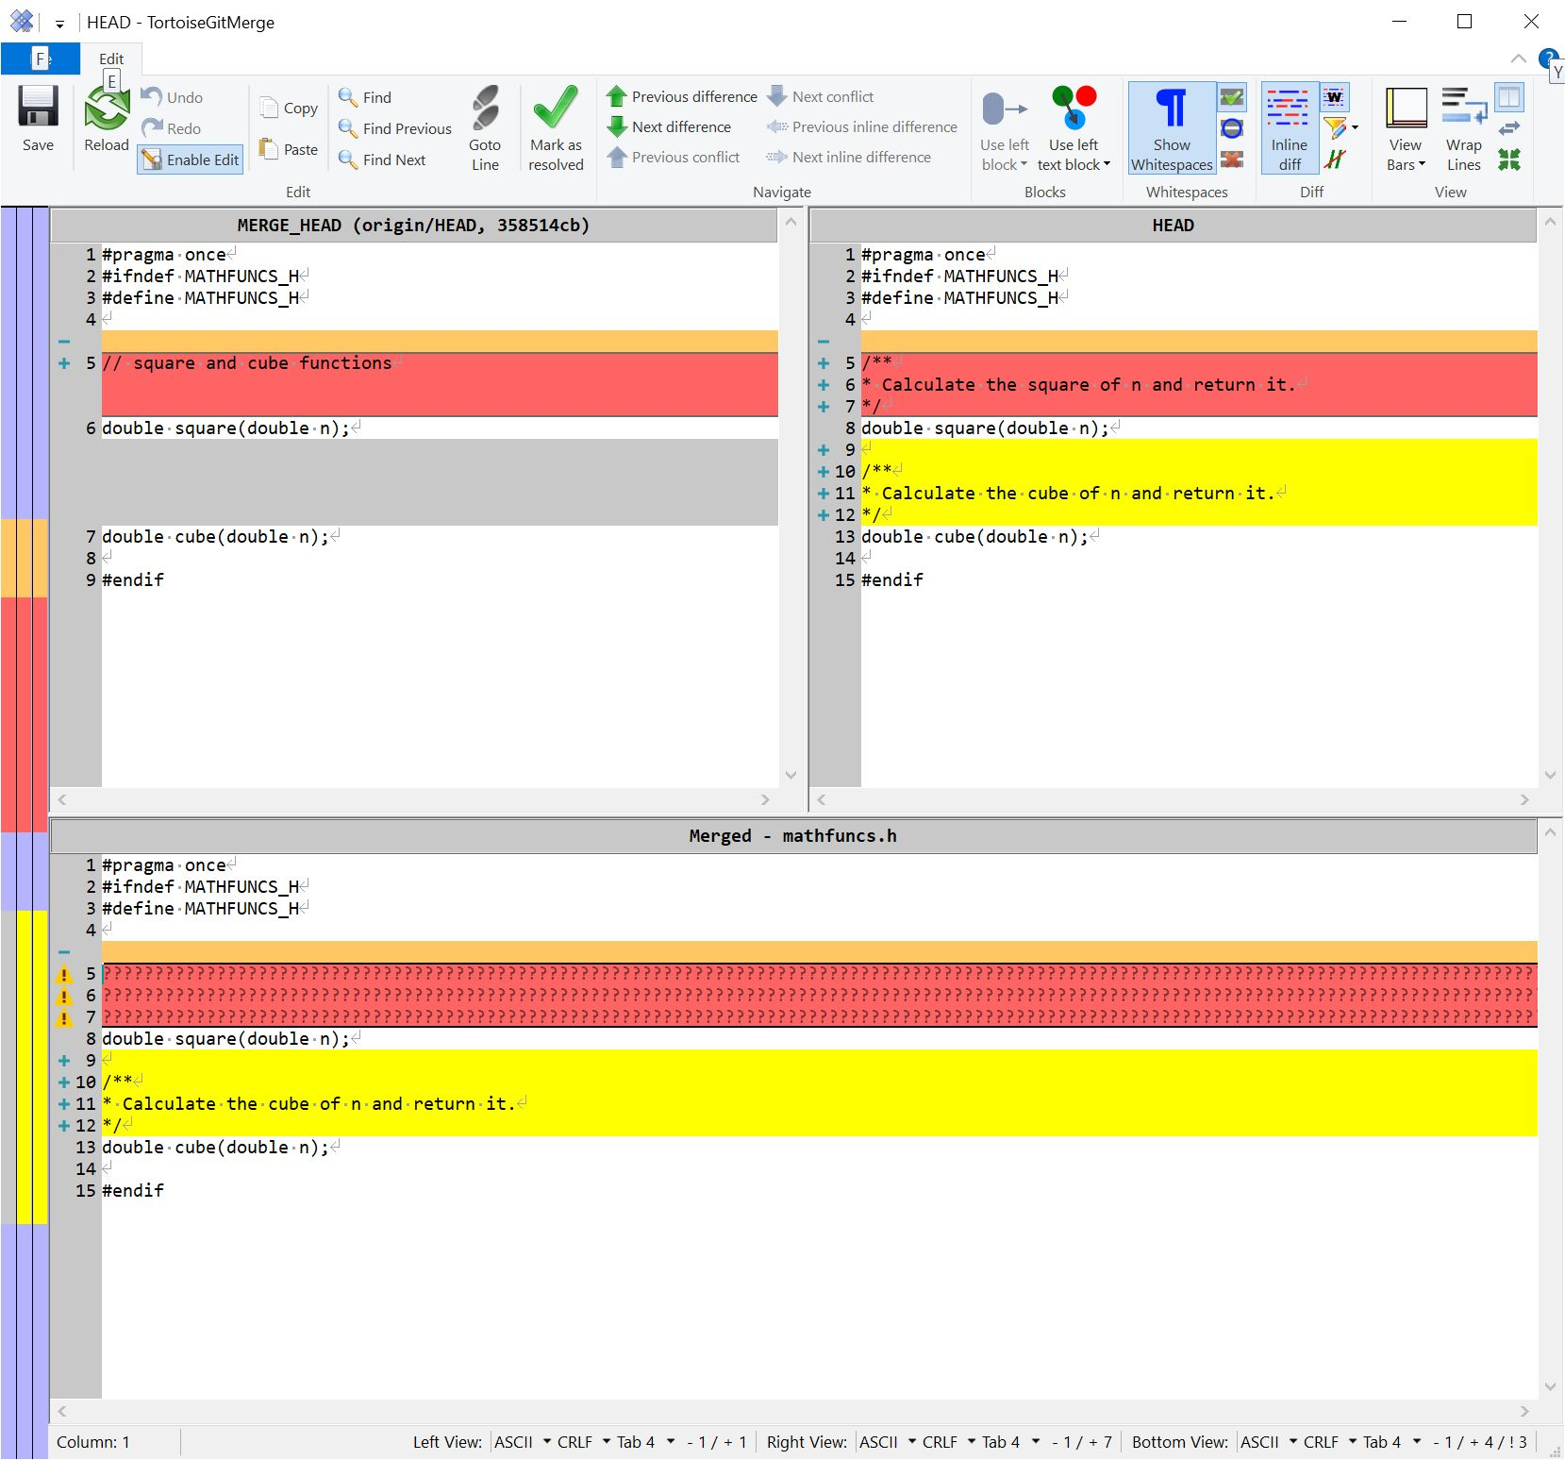
Conflicts – Two developers Change the Same Line

